Slide 1
Welcome Bulldogs!
Please sit with your PLT
Pep Talk
Notes:
1/19/17

Slide 2
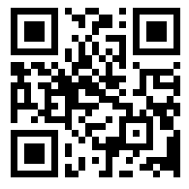
https://goo.gl/NR9AcC
Access the presentation

Slide 3
Agenda
Video | Pep Talk | 3 min
Purpose | Desired Teacher Outcomes// Introduce Team | 4 min
Tiered System | Tier I/ EASi for Parent Communication/ Notes | 10 min
 | Tier II - Steps/ Strategies/ Key Players | 5 min
 | Tier III - Steps/ Strategies/ Key Players | 5 minutes
Resources | Design a lesson to submit | 3 minutes
My Computer→ Shared-->Groups-->Staff-->PD

Slide 4
Desired Outcomes
Understand the three-tiered model and who is on the Intervention Team.
Dialogue about current intervention process to determine what went well and what might be improved.
Implement the three-tiered model using research-based strategies and interventions to ensure student success.

Slide 5
Take 2 minutes in your PLT
What are some possible things that worked well and some areas of improvement you see with the current intervention process
Notes:
Have PLT present one of each.

Slide 6
Improving our process for Intervention
SP2020- To determine students eligibility for special education services
Strategic Plan of 95% graduation rate
Moving toward a Multi-Tiered System of Supports
To improve communication and processes for staff
To provide students with the right interventions at the right time
To provide teachers with a more time efficient and streamlined process around intervention

Slide 7
Who is our Bulldog Intervention Team?
Vanessa Perez – Administrator
Kimberly Schlink – Intervention Coordinator
Elaine Vinson – School Psychologist
​Sonja Poole - Dean of Students
TBD – Literacy Coach
Marco Pardo-Counselor
LeAnn Swanson – LEP
Quincy Ratcliff – SAP
James Williams – ALC/ CARE
LoveNder Alston- PBIS
Beverly Robinson - OCS
Annette Lynch - CTE Special Populations Coordinator
Matthew Whitehead - Gradpointt
Monnie Sutton - Career Academies
Ashley Thompson-Moran - CARE
Notes:
Multi-disciplinary team who gets together at least 2 times per month to
Examine student data around academics, behavior and attendance
be a resource to teachers and PLTs
Case manage students receiving tier II and tier III interventions

Slide 8
Intervention Team Case Managers
CTE- Ms. Lynch
English - Mr. Pardo
Fine Arts - Ms. Poole
Healthful Living - Ms. Poole
Library & Media - Mrs. Schlink
Math - Mrs. Schlink
Science - Ms. Perez
Social Studies - Ms. Ratcliff / Ms. Poole
Special Ed. - Ms. Alston / Mrs. Robinson
World Languages - Mrs. Swanson

Slide 9
3 Tier Model of School Support
No more than 5% of Students Should be here
Tier 3
Tier 2
No more than 15% of Students Should be here
At least 80% of Students Should be here
Tier 1

Slide 10
Total Student Population = 1,549
Intensive
Support
5% (n = 78)
Supplemental
Support
15% (n = 232)
Differentiated
Core
80% (n = 1,239)
Resources
Student Needs
Notes:
How did you come up with 80, 15 and 5 numbers? – The pyramid of multi-tiered systems of support is a framework through which schools provide integrated academic and behavior supports- and if we do that with fidelity

Slide 11
Tier I Means All-Students, All the Time, In Your Classroom
Big Picture
100% of students participate in Tier 1 (otherwise known as Core). About 80% of students should stay on track with standard schoolwide expectations, "good first teaching," adjusting instructional practices to re-teach and differentiate to meet student needs.

Slide 12
Tier I Strategies
Step 1: Teach-Reflect / Monitor
Reflect on teaching methods.
Reflect on use of various modalities.
During the first part of our PD today, you learned: Techniques to Check for Understanding and Process Activities.

Slide 13
Tier I Strategies
Step 2: Use PLT’s - compare data - strategies offered
Fidelity
Support
Common Assessments
Shared Practices

Slide 14
Tier I Strategies
Step 3: Meet w/ Student – Adjust / Differentiate
Ask students what their challenges are in your class.
What do students think will improve their ability to learn the content in your class?
Model and provide strategies for note-taking and organization
Examine what might need to be changed in instruction, curriculum and environment.
Assign tutoring
Recommend practice or review websites or your website.

Slide 15
Tier I Strategies
Step 4: Communicate w/ Parents
Contact parents at first sign of struggle.
Difficulty finding working number? Ask the student.
Still having difficulty? Contact IT Case Manager.
Document ALL communication in EASi under Parent Contact and Notes
Board Policy 3400- Parent Communication

Slide 16
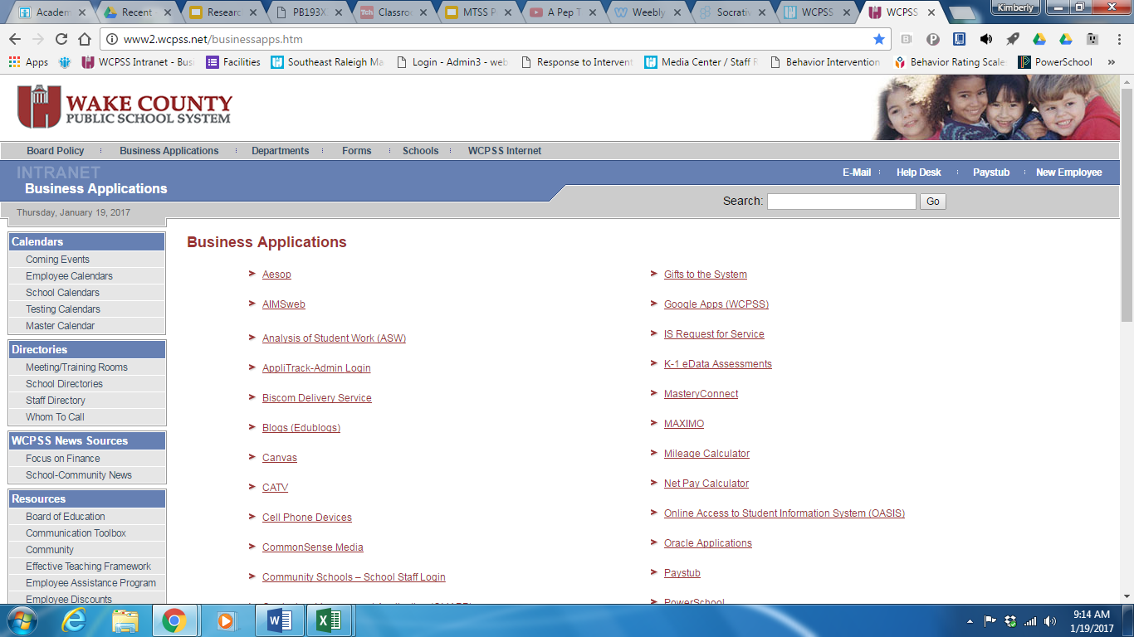

Slide 17
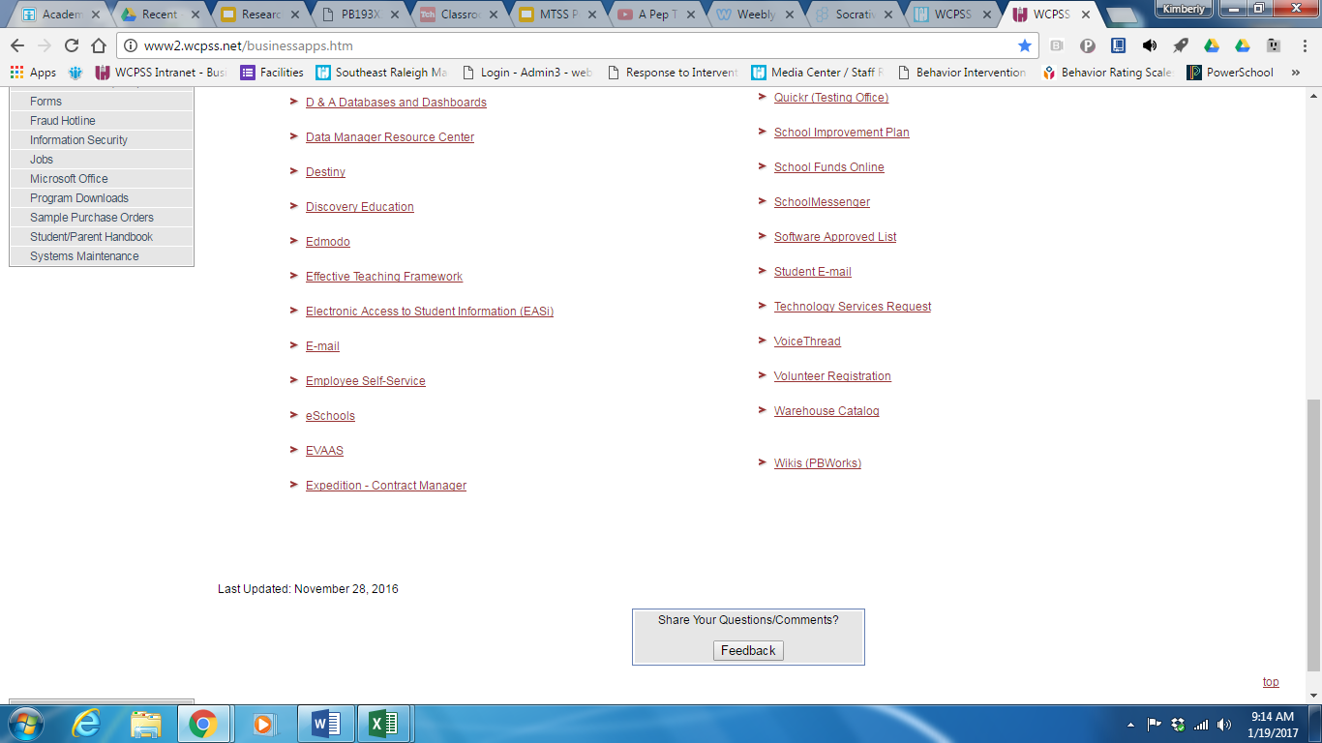

Slide 18
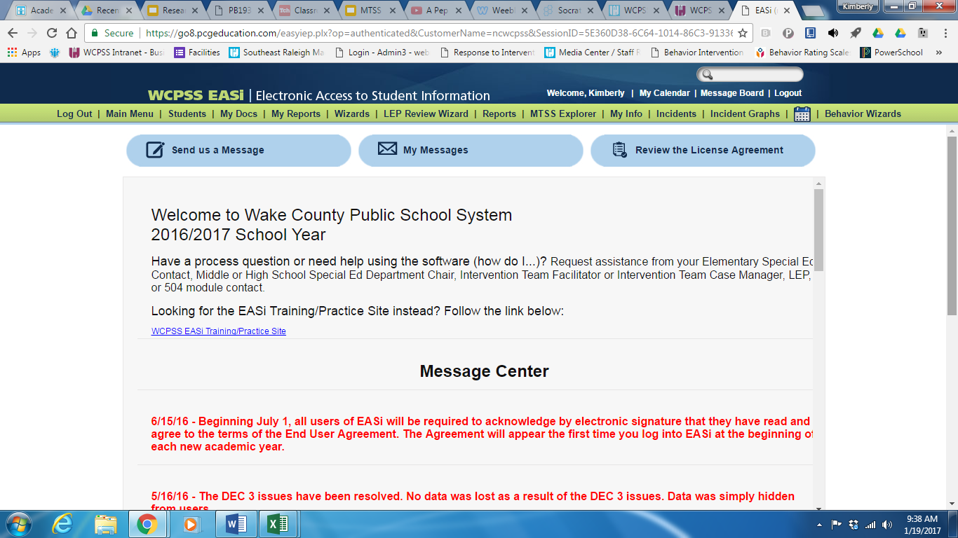

Slide 19
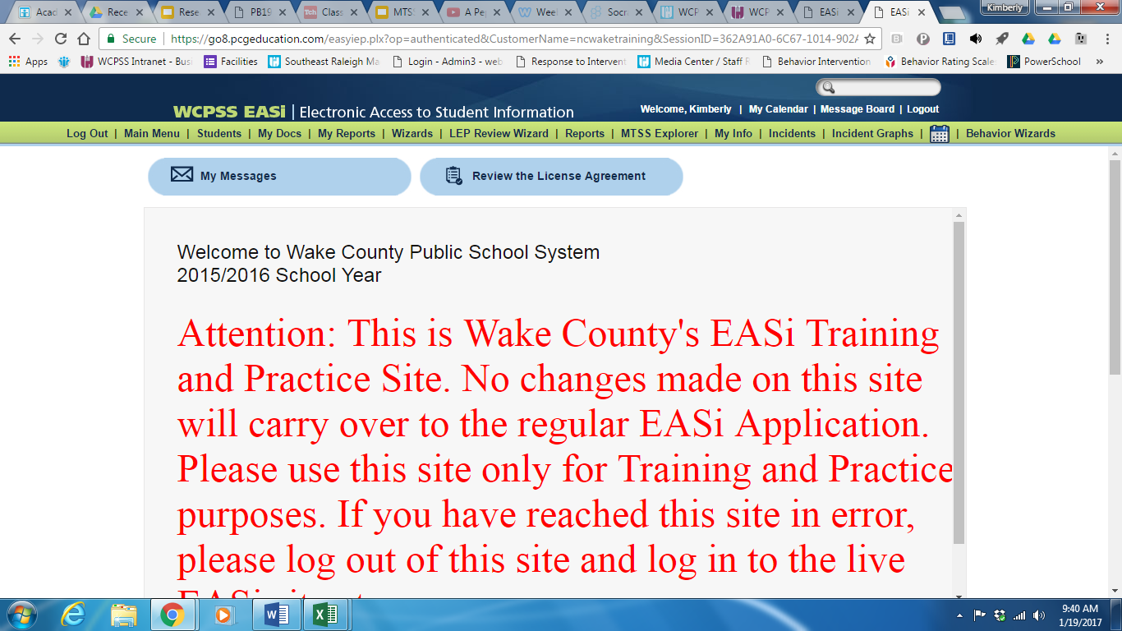

Slide 20
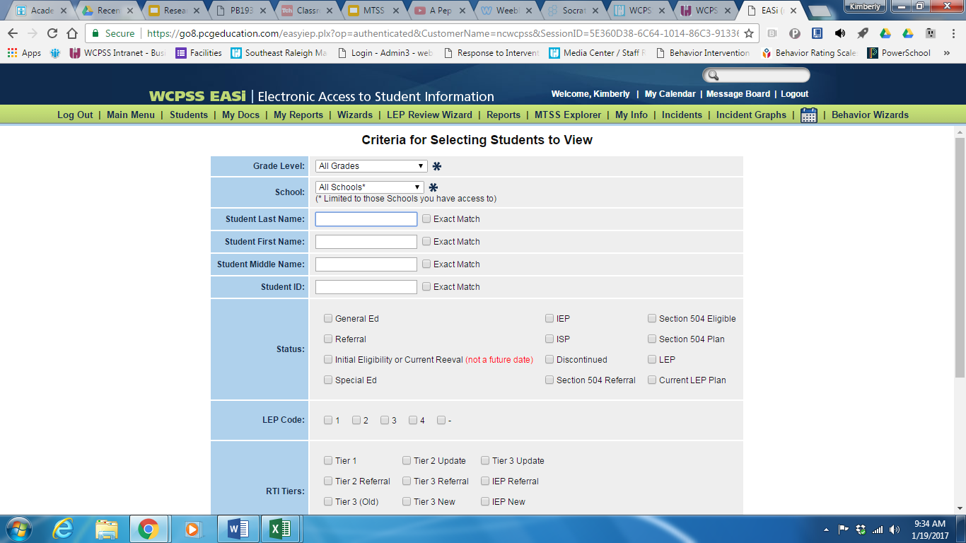

Slide 21
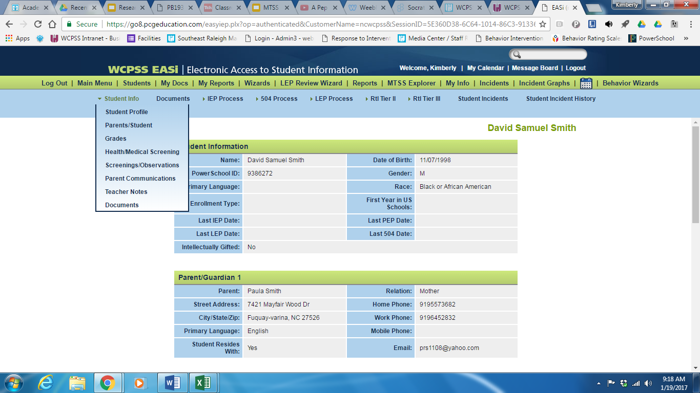

Slide 22
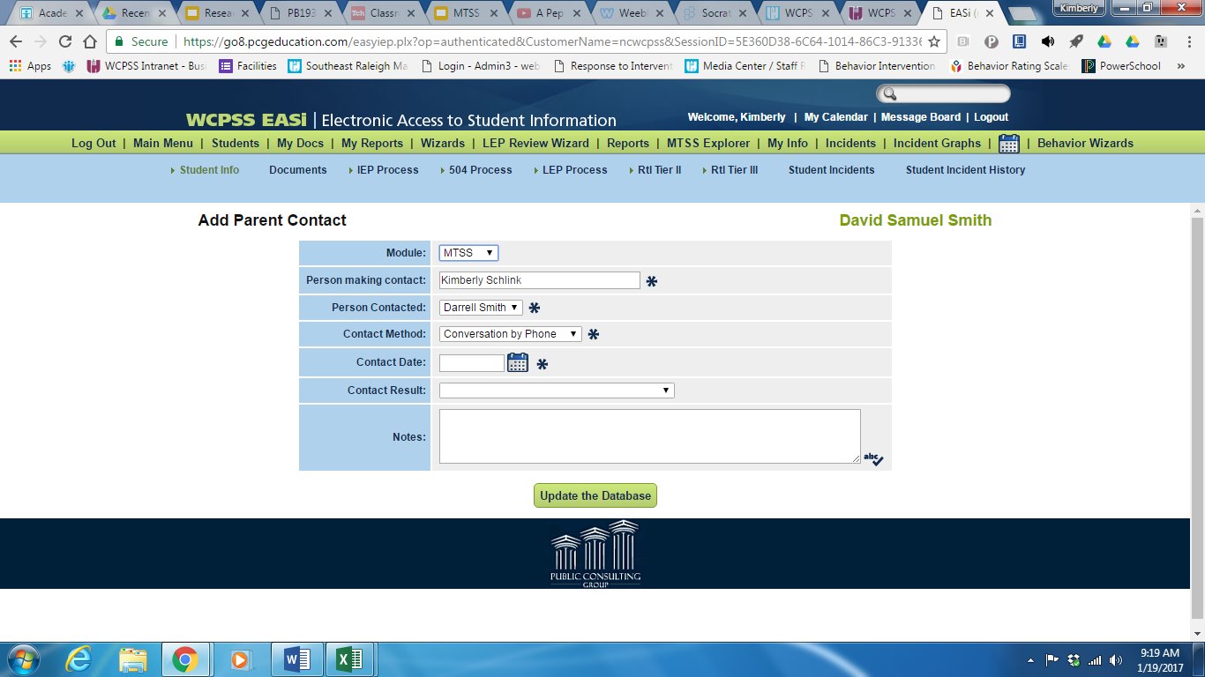

Slide 23
Academic and Behavioral Strategies for Tier 1
Re-teaching
Scaffolding
Tiered Assignments
Projects
Additional Time
Technology
Chunking
Timely Feedback
Hands-on learning
Modified Assignments
Rubrics
Graphic Organizers
Flash Cards
Copy of Notes
Peer Tutoring
After-School Tutoring
Behavioral Cuing
Seat Change
Seminar
In-Class Reward System
Attendance Contract
School Detention
Reinforcement of Bulldog Matrix

Slide 24
Tier I Strategies
Step 5: Contact student's counselor and Intervention Team Case Manager for additional strategies and interventions
Counselor intervention
Tier 1: Student meets with their grade level counselor for review of progress & discuss strategies
Mr. Pardo 9th Grade
Ms. Shaw 10th - 12th A - G
Mr. Lee 10th - 12th H - N
Ms. Hall 10th -12th O - Z

Slide 25
When students are not responding to Tier I Strategies
Contact student's counselor and Intervention Team Case Manager with all documented parent contacts and interventions.
The teacher (s) and the Intervention Team will meet to discuss if the student needs Tier II interventions.
Notes:
If student is failing more than one course the team along with those teachers will create the Tier II plan.

Slide 26
Tier II
Big Picture
15% of students participate based on identified needs.
Small group instruction developed for students who are in need of strategic, evidence-based instruction in addition and aligned to Core, as evidenced by collected data.

Slide 27
Tier II Interventions
Step 1: Create a Tier II Intervention Plan
(Paper Form) Intervene with specific, targeted, evidence-based, measurable interventions.
Step 2: Ensure student signs a copy for your records. Give student a copy. Mail a copy home to parent @ address in PS.
Step 3: Communicate with parents, other teachers, counselors, and Intervention Team Case Manager.
Step 4: Progress-monitor the student to ensure the Tier II plan is working or if it needs to be adjusted. Progress-monitoring must occur every 3-4 weeks. This will need to be documented
Step 5: If Tier II plan was implemented with fidelity and progress-monitoring data shows the student is not making adequate progress meet with IT Case Manager to see if student should move to Tier III.

Slide 28
Tier II Interventions
Small Group
Questioning
Peer Tutoring
Real World Connection
Inquiry Based Teaching
Gradpoint/ Objective Recovery
Cooperative Learning
Teacher Clarity
Guided Notes
Modeling
Problem Solving - Teaching
Routines / Procedures
After School Tutoring
Student Choice
Attendance Contract
Giving Feedback on Students Performance

Slide 29
Tier III Intensive Intervention for Those Not Responding to Tier I or Tier II
Big Picture
Only 5% of students should be receiving Tier 3 Interventions.
It is an opportunity to provide intensive, evidence-based instruction maximizing intensity, frequency, and duration for students struggling the most academically and behaviorally.

Slide 30
Tier III Interventions
Determined based upon multiple data points including academic, behavior and attendance data
Intensive, individualized instruction
School-wide specialists are included in the individualized instruction/intervention
Functional Behavior Assessment/Behavior Plan created if needed
Placement in credit recovery through Gradpoint
Environmental relocation to ALC
*If Tier III plan was implemented with fidelity and progress-monitoring data shows the student is not making adequate progress the Intervention Team will determine if further evaluation is needed

Slide 31
SRMHS Pyramid of Interventions
https://goo.gl/EJR3Ju

Slide 32
Resources
https://drive.google.com/drive/folders/0B2hc-iFQjsUDWWotZU4xalppUkE?usp=sharSRMHS Intervention Resourcesing

